Slide 1

SAKSHI SINGH
AUTHOR. WRITER. TEACHER
Mumbai based Sakshi Singh is a poet and an international journalist. Her book Rat-a-tat poems and Jalebi Jingles are available in India and Europe and are being used to teach poetry in schools across India and U.K. Her books are also available in Braille, Spanish and will soon be out in French and other regional and international languages. She conducts workshops for kids under ‘‘Fresh Rhyme Water’’ ™ and therapeutic writing workshops for teenagers and adults under ‘Words For Your Wellness’. Her 3rd book of poems ‘’If I Could Teach My Teacher’’ has been released in 2018.

Slide 2

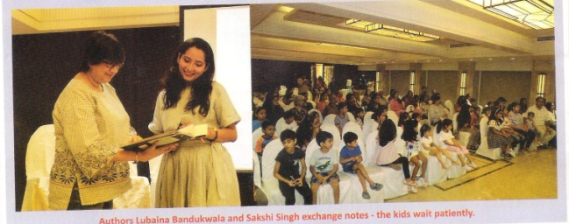
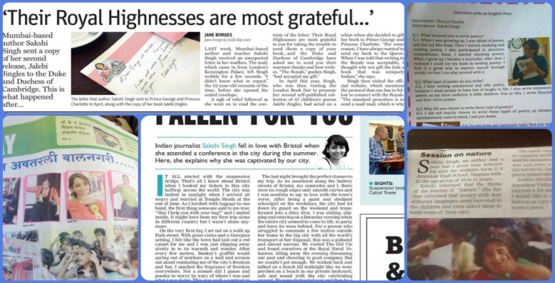
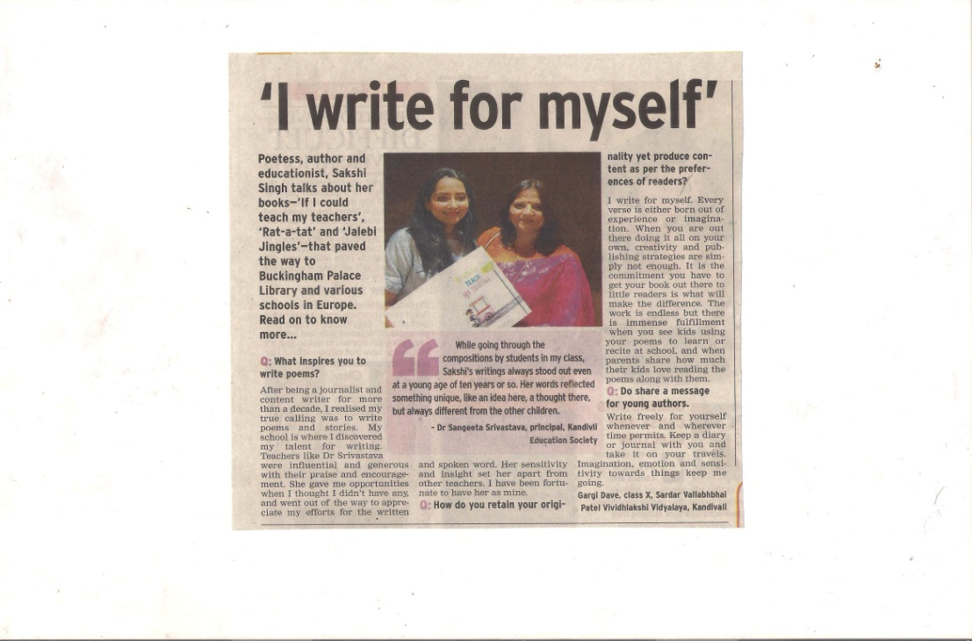
SAKSHI SINGH
AUTHOR. WRITER. TEACHER

Slide 3
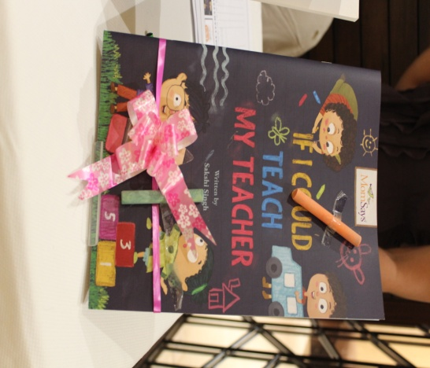
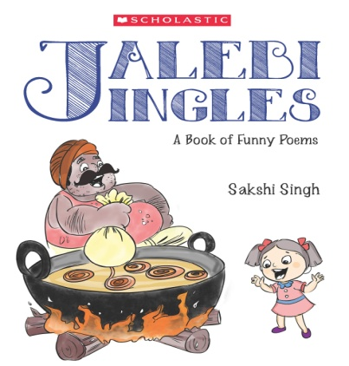
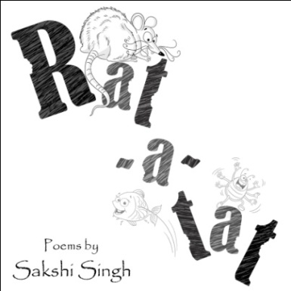
SAKSHI SINGH
AUTHOR. WRITER. TEACHER
FIND SAKSHI ONLINE
Website: https://sakshissongs.wordpress.com/
Twitter: https://twitter.com/sakshissong
Email Address: sakshissong@gmail.com
Books available on Amazon and Bookstores in India- Kitab Khana and Kahani Tree

Slide 4
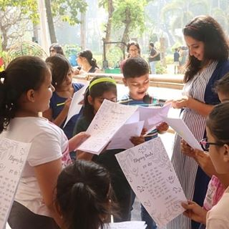
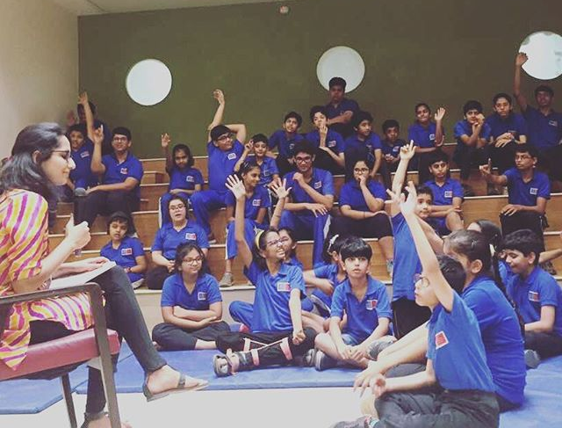
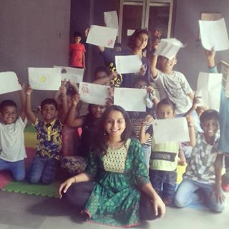
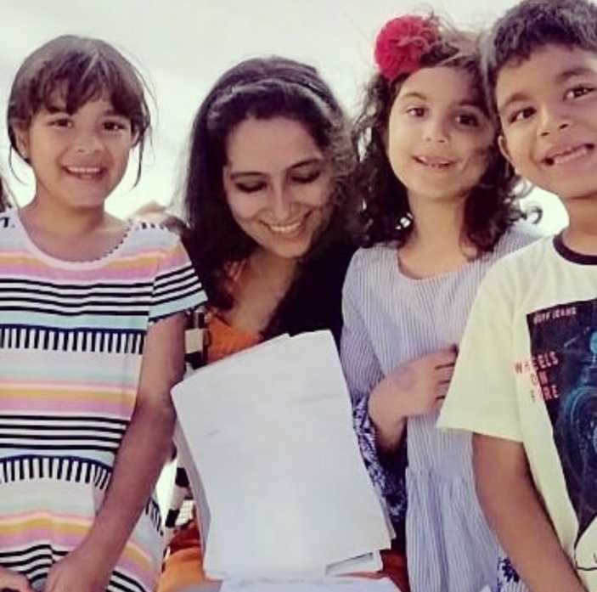
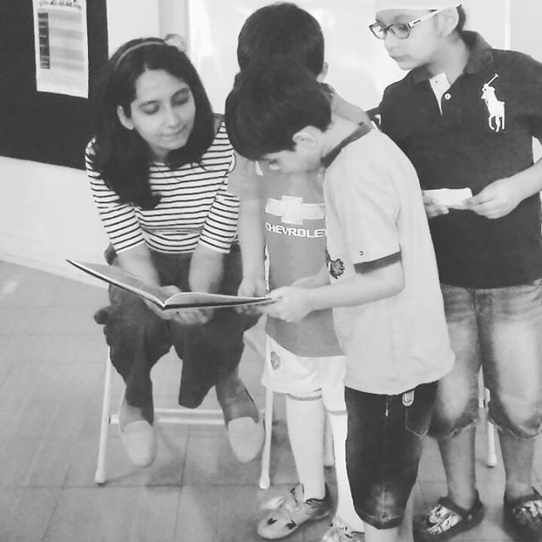
SAKSHI SINGH
AUTHOR. WRITER. TEACHER

