Slide 1


“The kids just couldn't stop laughing and thoroughly enjoyed the book. Author Sakshi obviously has a good sense of humour and has written about the most random things and ideas.”
-Kids Stop Press

Slide 2
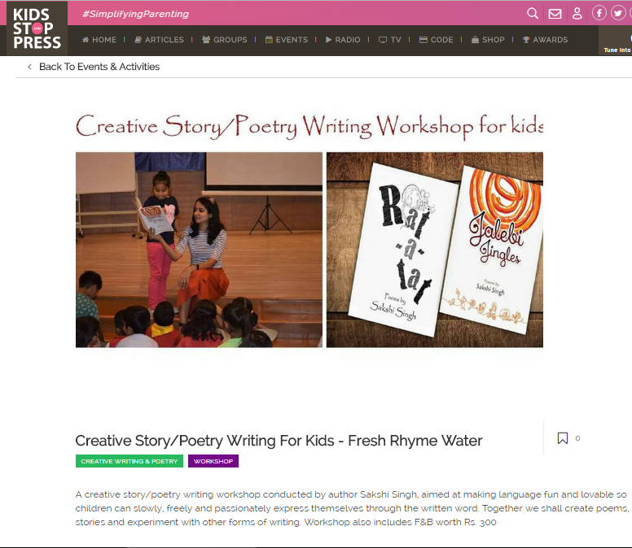

Slide 3

“From snails and zoos, to noodles, clocks and televisions, the poems’ themes are as diverse and fascinating as the world around us. The poems are accompanied by fascinating black and white illustrations that are sure to catch your eye!”
-Robin Age

Slide 4

“Some poems make us laugh
While some teach us new words
Some make us wonder
While some make us ponder
Some of them set us in the mood
To eat some yummy food“
-Indian Moms Connect

Slide 5

“The main idea behind writing for children should be to make the language simple, easy to understand and it should sustain the interest of the reader. This is exactly what Sakshi Singh’s Jalebi Jingles achieves“
-Kids Stop Press

Slide 6

“The poems are short and whimsical. The black and white illustrations that accompany each poem are fun and useful for the child reader to grasp the meaning of the lines“
-Plus Minus N More

Slide 7
“Each poem represents our day-to-day activities in a funny, rhythmic and poetic manner which helps the kids to relate to them easily. If you are looking for a light, read-aloud and rhythmic book for kids, check Jalebi Jingles out“
-Indian Moms Connect

Slide 8

“I loved it, because it is totally different. I enjoyed the delicious oriental taste and I was able to know - from the child's point of view - several of the customs of India. I recommend reading "Jalebi Jingles"“
-La Noticia En Guatemala

Slide 9



Slide 10



Slide 11
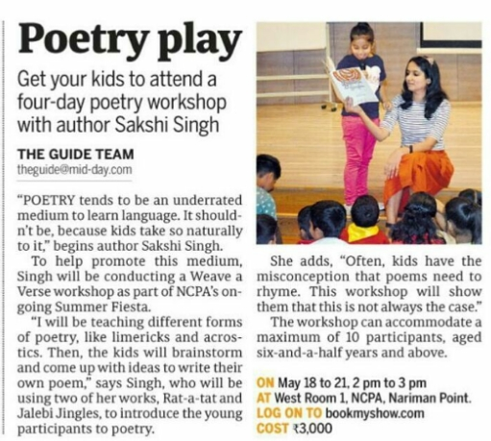

Slide 12



Slide 13



Slide 14
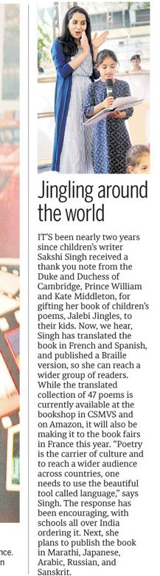

Slide 15

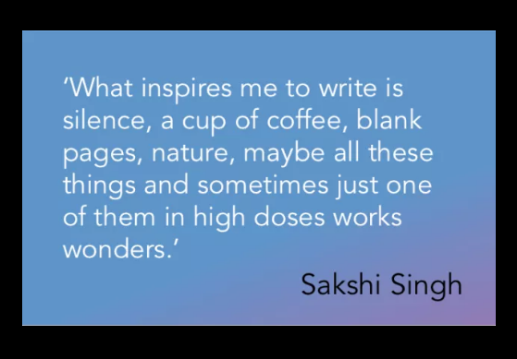

Slide 16

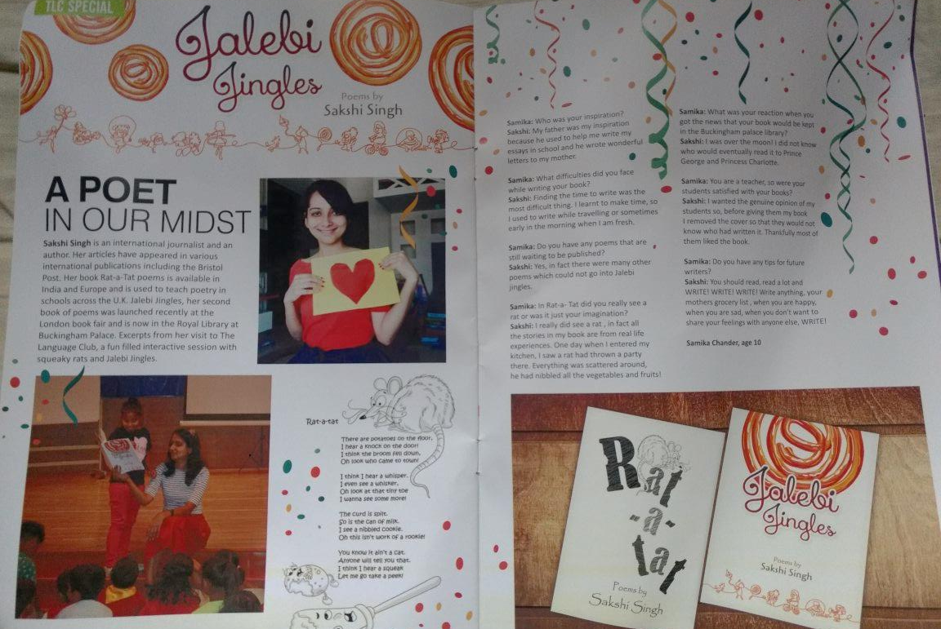

Slide 17

